Slide 1
COMMUNITY SERVICE INITIATIVE UCM60102U
CHOW HONG DA 0318571
ENG SHI YI 0317849
FONG TZE YING 0324073
FOONG LIH WEY 0322689
LEE PUI SAN 0319089
TAN WEI ZHEN 0318560
TANG ZE ZHENG 0318967
TOO MUN FAI 0318214

Slide 2
FOLDI – FURNI AN ORPHANAGE HOME PROJECT

Slide 3
01 | objective
Provide additional furniture for the orphanage
Create a space-efficient furniture for the orphanage
Allow children to easily deploy the furniture without assistance

Slide 4
02 | site chosen
Name: Rainbow Home/ Rumah Pelangi
Location: No. 125, Jalan Pakis 2, Taman Ferngrove, Selangor, 43200 Cheras 9 Miles, Malaysia
Year it started: 2002
Number of Children: 28

Slide 5
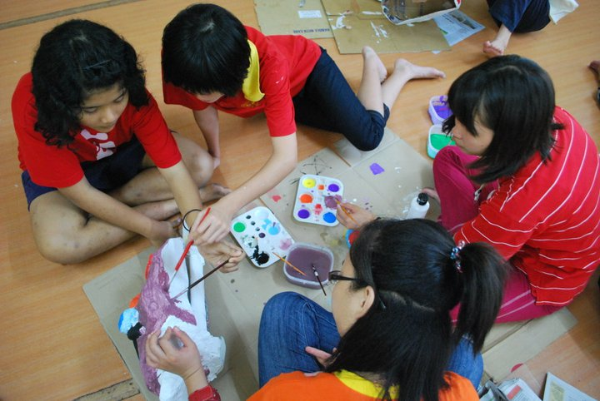
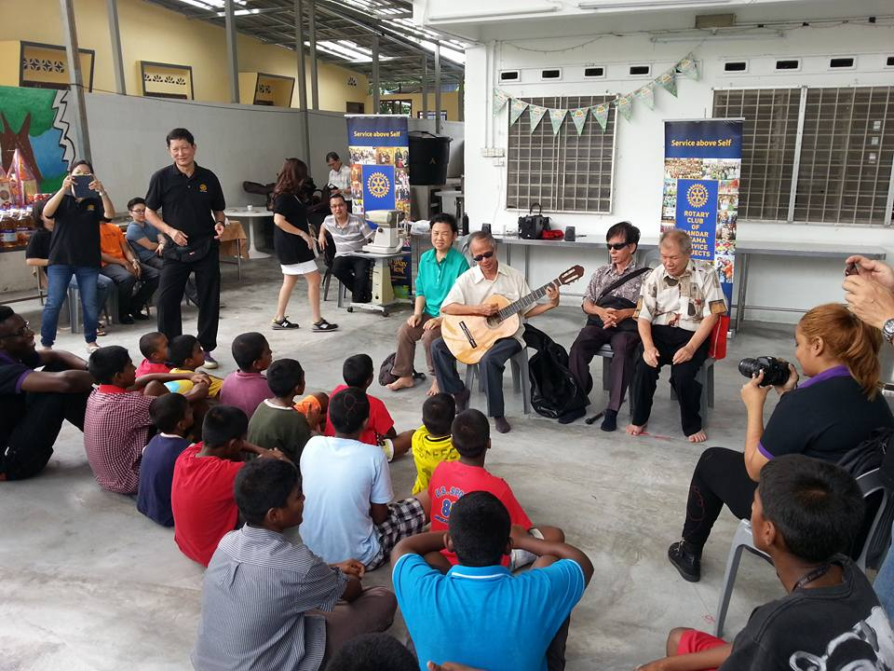
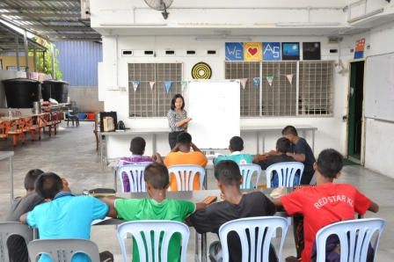
03 | issues
Lack of children friendly furniture and efficient storage. Kids sit on the floor. Standard plastic chairs are not suitable for young children to sit
Children are forced to sit on the floor while having activities and meetings.
Children are fond of playing with anything that they come into contact with

Slide 6
04 | anthropometry
150
1000
500
1200
200

Slide 7
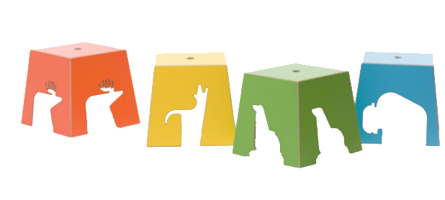
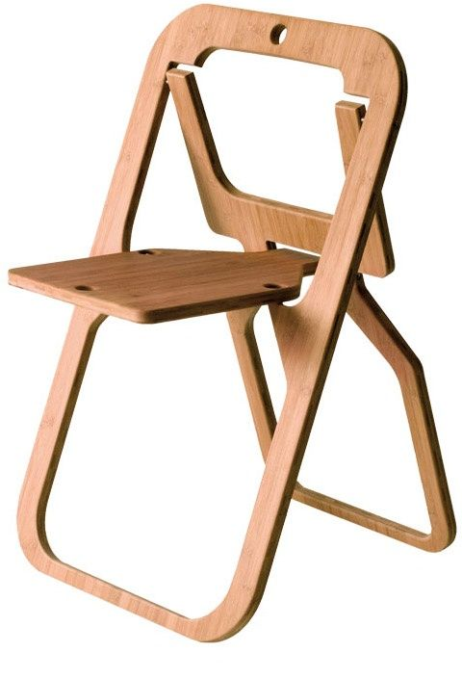
05 | case study
ZOO kid’s stool
A kid-friendly design for a folding chair
‘Oyster’ chair by Kawamura Ganjavian
bring a touch of cosiness to sleek, contemporary furniture
Desile Folding Chair by Christian Desile
When folded and hung, provides graphic interest to a space

Slide 8
05 | conventional method
Plastic Chairs
Disadvantages:
Break easily within a short span of time
Unable to withstand heavy weight and pressure
Plastic furniture lacks boldness and elegance
Not eco-friendly
Advantages:
Cheap , comfortable and stylish
Light weighted
Low or no maintenance cost. It is unbreakable
Available in vibrant colours and can change the appearance and the mood of the room
Usage of plastic reduces cutting of trees and thereby deforestation

Slide 9
05 | proposed idea
Foldable Chairs
Advantages:
It can be available for every class of
humanity in cheap and sophisticated way
Convenience of usage.
Mobility.
Durability.
Flexible Storage
Low maintenance cost
Disadvantages:
Constantly folding and unfolding will loosen the compartments
Expensive when compared to plastic chairs

Slide 10
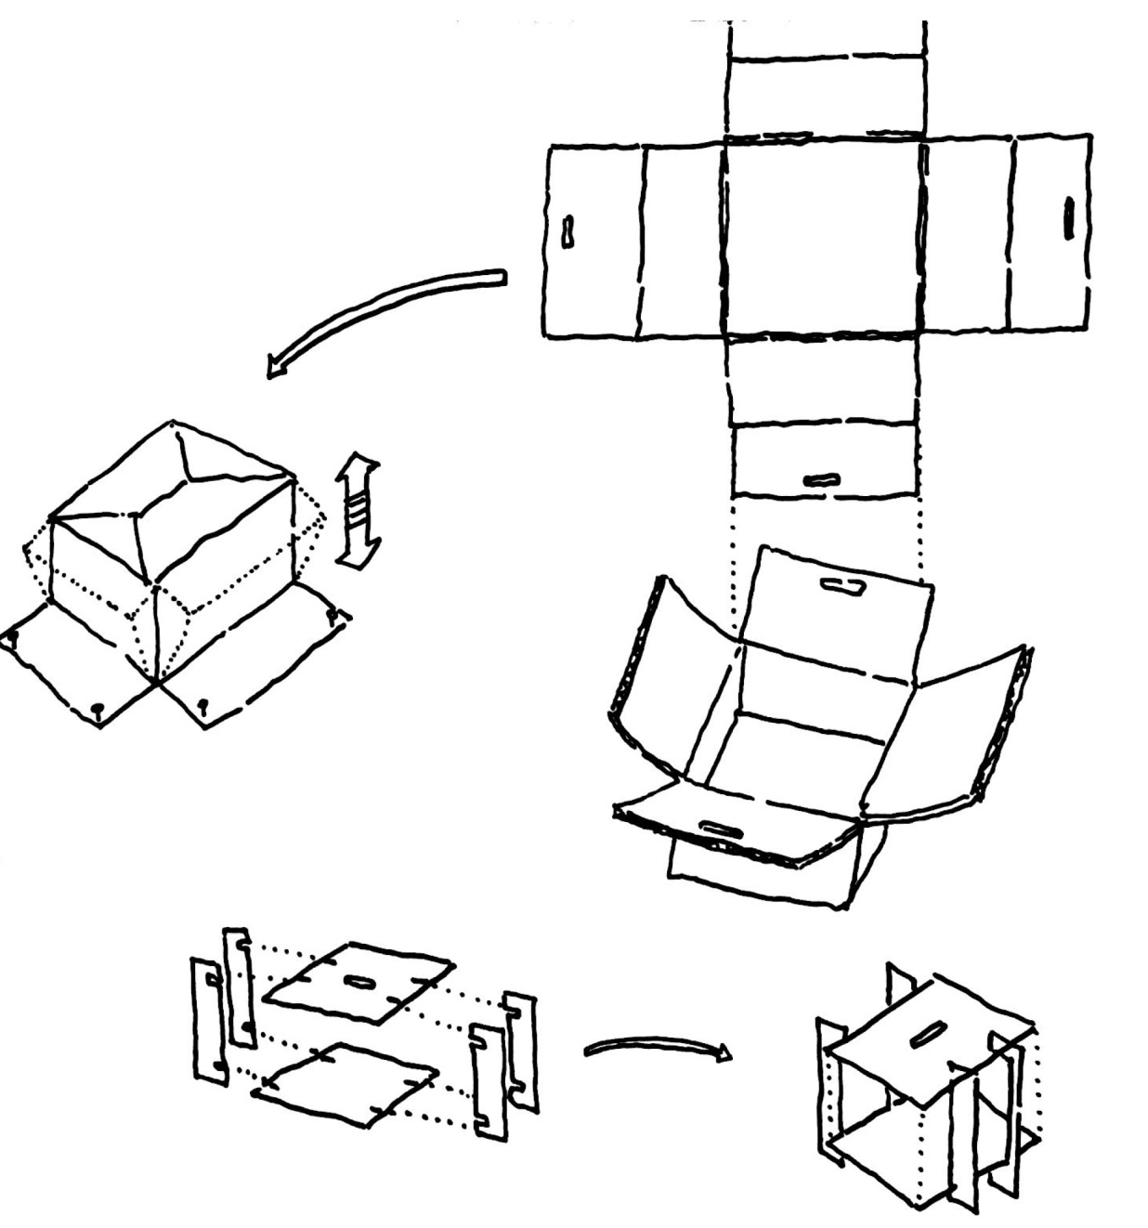
06 | Design Intention
Design simple mechanism to avoid injuring the children
Included folding joints to save space
Material : utilized recyclable corrugated cardboard / timber

Slide 11
THANK YOU

